Slide 1
Chronic Kidney Disease Analysis Using Machine Learning
-G.Sri Harsha(17RH1A0569)
-K. Sri Chandana(17RH1A05B7)
-G.Vasavi(17RH1A0571)

Slide 2
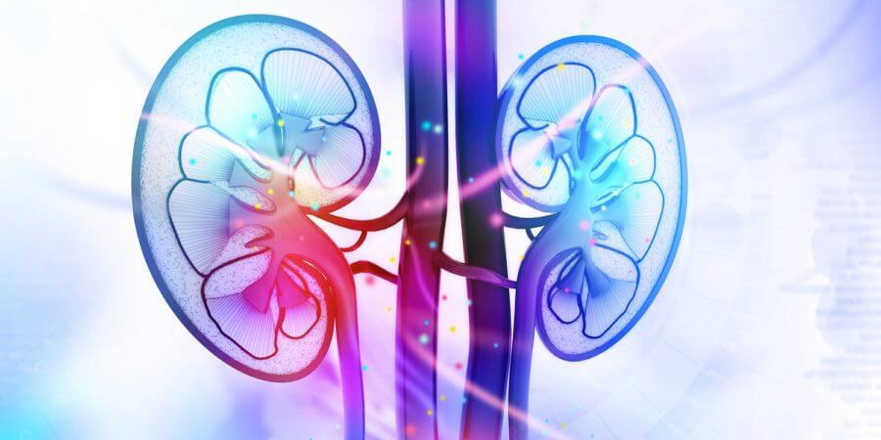
INDEX:
Introduction
Problem Definition
Aim of Study
Solution
Architecture
Requirements
Advantages
Conclusion

Slide 3
INTRODUCTION:
As the past records show, the number of deaths in India due to chronic kidney disease (CKD) were 5.21 million in 2008 and this number can be further raised to 7.63 million by 2020.
There is need of detection of the chronic kidney disease at early stage before getting it worse.
To reduce mortality rate, an efficient technique is required to predict and classify it.

Slide 4
PROBLEM DEFINITION:
Chronic kidney disease (CKD), in its early stages, has no symptoms; testing may be the only way to find out if the patient has kidney disease .Early detection of CKD in its initial stages can help the patient get effective treatment and then prohibit the progression to ESRD .To raise awareness and to encourage those who are most susceptible to the disease to perform the tests periodically, we hope that the disease can be detected with the least possible tests and at low cost.

Slide 5

AIM OF STUDY:
The objective of this research is to provide an effective model to predict the CKD by least number of predictors.

Slide 6
SOLUTION:
There are many researchers who work on prediction of CKD with the help of many different classification algorithm .
We get result on dataset which having 400 records and 25 attributes which gives result of patient having CKD or not CKD.
Using k-nearest neighbours, random forest and neural network will get results.

Slide 7
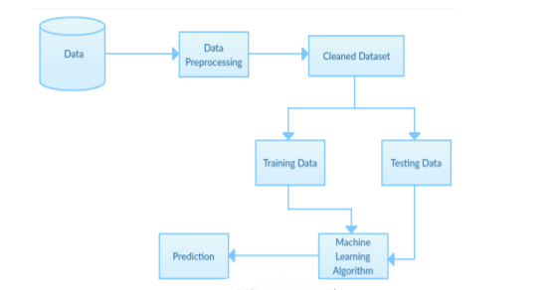
ARCHITECTURE:

Slide 8
REQUIREMENTS:
Software :
OS : Windows
Python: python 2.7.x and above Pycharm IDE
Setup tools and pip to be installed for 3.6.x
Hardware :
RAM :16GB and higher
Processor: Intel i5 and
Hard disk : 1000GB and minimum python
Algorithms : Logistic Regression and decision tree.

Slide 9
ADVANTAGES :
The advantage of this system is that, the prediction process is less time consuming.
It will help the doctors to start the treatments early for the CKD patients and also it will help to diagnose more patients within a less time period

Slide 10
CONCLUSION:
From the results analysis, it is observed that the decision tree algorithms gives the accuracy of 91.75% and SVM gives accuracy of 96.75%. When considering the decision tree algorithm it builds the tree based on the entire dataset by using all the features of the dataset. The advantage of this system is that, the prediction process is less time consuming. It will help the doctors to start the treatments early for the CKD patients and also it will help to diagnose more patients within a less time period

Slide 11

THANK YOU

